Slide 1
UNIX Shells
Key Pressed | Result
Backspace, Ctrl-h | Back up & erase last character
Ctrl-c | Terminates the current command (watch out for Ctrl-z: suspend command)
Ctrl-s | Stops scrolling of output on screen (Ctrl-q to resume/start scrolling)
Ctrl-w | Delete previous word on command line (from cursor back)
Ctrl-u | Erases/deletes entire command line
12
A crash intro: the shell, permissions and files

Slide 2
UNIX Shells
Key Pressed | Result
Cntl-a | Go to beginning of line
Ctrl-e | Go to end of line
Esc-f | Go forward one word
Esc-b | Go back one word
Esc-d | Delete word (from cursor to end of word)
Cntl-d | Delete character at cursor
Cntl-k | Delete from cursor to end of line
13
A crash intro: the shell, permissions and files

Slide 3
The UNIX file system
hierarchical organization of files
contains directories and files
basic commands to list and manipulate files
independent of physical file system organization
always single tree
typical Unix file system types
ext3 (formerly ext2)
reiserfs
vfat
ntfs (now read & write)
15
A crash intro: the shell, permissions and files

Slide 4
The UNIX file system
ls
Show what’s in a directory
pwd
Show where we are
cd path
Go somewhere
18
A crash intro: the shell, permissions and files

Slide 5
The UNIX file system
/
Root directory (top in any UNIX structure)
~
Home directory, owned by a user. It’s where you start when you log in as user.
..
Parent directory
.
Current directory
19
A crash intro: the shell, permissions and files

Slide 6
The UNIX file system
Let’s try on a couple of examples.
cd /home/aqualonne/Desktop
cd lib/lsb
cd ./var
Absolute
Relative
Relative
21
A crash intro: the shell, permissions and files

Slide 7
Example: trying to install software
sudo command
Execute a command as root
su
Login as root. VERY, VERY RISKY!
apt-get install
Install a program
Logoff. If logged on multiple names, you’ll go back to your previous id.
exit
26
A crash intro: the shell, permissions and files

Slide 8
Changing permissions
Optional
-R for recursive will apply the new permissions to everything from that folder
chmod
options
who
operations
permission
file
u for user
g for group
o for others
a for all
+ for add
- for remove
= for assign
r for read
w for write
x for execute
% chmod ug=rwx,o=rx sort.c
% chmod ugo+rx,go+w sort.c
% chmod u=rwx,g+w,o-w memo.doc
Examples:
41
A crash intro: the shell, permissions and files

Slide 9

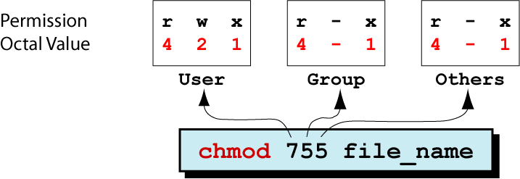
Changing permissions
% chmod ug=rwx,o=rx sort.c
% chmod ugo+rx,go+w sort.c
% chmod u=rwx,g+w,o-w memo.doc
We tend to see this style as being really, really ugly.
Instead, we prefer to use the octal value. It’s very short so after some practice you get used to it. Whereas the long one, even after practice, stays long.
To understand what’s going on, we need to understand a little bit about binary coding. So, short aside...
42
A crash intro: the shell, permissions and files

Slide 10
Changing permissions
Faster approach to setting octal values:
For each of the three groups (you-friends-strangers):
To allow reading, +4
To allow writing, +2
To allow running, +1
My file is totally private, nobody else should do a thing on it.
chmod 700 file.doc
Examples:
I work on my file with my group
chmod 770 file.doc
It’s ok if anybody uses my file but only I can modify it
chmod 755 file.doc
49
A crash intro: the shell, permissions and files

Slide 11
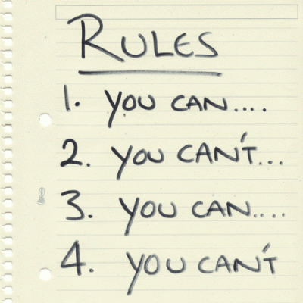
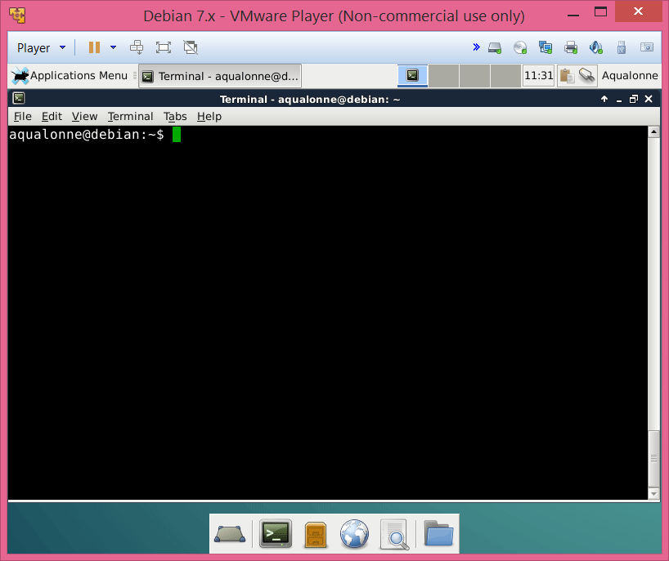
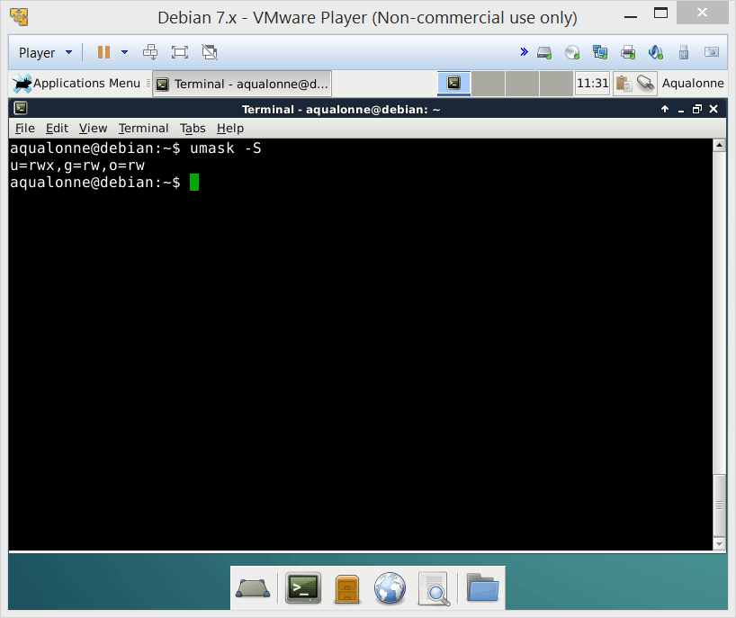
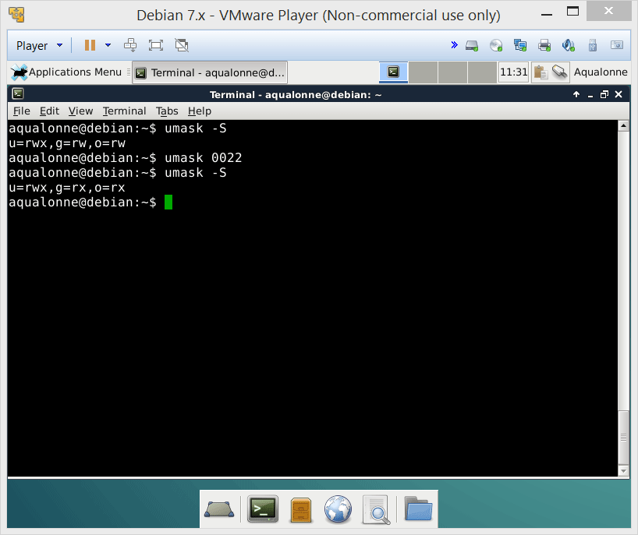

Default permissions
The admin sets the rules: these are the default permissions that all new files and folders will have
The value you give in umask is not the value that you want for permissions!
These are the default permissions.
If you want everybody to do anything, umask 777 is not going to give you that!!!
If you want to change the default permissions, you use umask with a value.
52
A crash intro: the shell, permissions and files

Slide 12
Default permissions
These are the permissions your system starts with:
Directory File
rwx rwx rwx rw- rw- rw-
111 111 111 110 110 110
& 111 101 101 & 111 101 101
111 101 101 110 100 100
rwx r-x r-x rw- r-- r--
Umask “filters” from these permissions
umask 022
To binary
Swap
000 010 010
111 101 101
53
A crash intro: the shell, permissions and files

Slide 13
Default permissions
These are the permissions your system starts with:
Directory File
rwx rwx rwx rw- rw- rw-
111 111 111 110 110 110
& 010 010 010 & 010 010 010
010 010 010 010 010 010
-w- -w- -w- -w- -w- -w-
Umask “filters” from these permissions
umask 555
To binary
Swap
101 101 101
010 010 010
54
A crash intro: the shell, permissions and files

Slide 14
Default permissions
User mask Value | Directory Default: 777 | File Default: 666
000 | 777 (rwx rwx rwx) | 666 (rw- rw- rw-)
111 | 666 (rw- rw- rw-) | 666 (rw- rw- rw-)
222 | 555 (r-x r-x r-x) | 444 (r- - r- - r- -)
333 | 444 (r- - r- - r- -) | 444 (r- - r- - r- -)
444 | 333 (-wx –wx –rx) | 222 (-w- -w- -w-)
555 | 222 (-w- -w- -w-) | 222 (-w- -w- -w-)
666 | 111 (- -x - -x - -x) | 000 (--- --- --- )
777 | 000 (--- --- --- ) | 000 (--- --- --- )
55
A crash intro: the shell, permissions and files

Slide 15

rwx
user ID
group ID
sticky bit
Attributes
Access control lists
58
A crash intro: the shell, permissions and files

Slide 16
What are they?
SUID (Set owner User ID up on execution)
Run a program with the permissions of the user the program belongs to, not your own
Example
To change your password, you need to edit system files /etc/passwd that belong to the root
So passwd belongs to the root and it set with SUID to give root permissions.
“lean” concept for the security of files and directories
suid | sgid | stb | r | w | x | r | w | x | r | w | x
4 | 2 | 1 | 4 | 2 | 1 | 4 | 2 | 1 | 4 | 2 | 1
7 |  |  | 7 |  |  | 7 |  |  | 7
Special |  |  | user |  |  | group |  |  | others
59
A crash intro: the shell, permissions and files

Slide 17
What are they?
SGID (Set Group ID up on execution)
Run a program with the permissions of the group the program belongs to, not your group’s
Example
Enforcing quotas: if anybody starts dumping data into a directory, it takes quota from the group the directory belongs to.
“lean” concept for the security of files and directories
suid | sgid | stb | r | w | x | r | w | x | r | w | x
4 | 2 | 1 | 4 | 2 | 1 | 4 | 2 | 1 | 4 | 2 | 1
7 |  |  | 7 |  |  | 7 |  |  | 7
Special |  |  | user |  |  | group |  |  | others
60
A crash intro: the shell, permissions and files

Slide 18
What are they?
STB (STicky Bit)
Only the owner or root can delete or rename the file.
Example
If you have write/execute permissions for a directory, you can trash its content even if you don’t own it. So one user could delete the /tmp folder that others use. So tmp has STB.
“lean” concept for the security of files and directories
suid | sgid | stb | r | w | x | r | w | x | r | w | x
4 | 2 | 1 | 4 | 2 | 1 | 4 | 2 | 1 | 4 | 2 | 1
7 |  |  | 7 |  |  | 7 |  |  | 7
Special |  |  | user |  |  | group |  |  | others
61
A crash intro: the shell, permissions and files

Slide 19
How to see them
The ls –l command doesn’t have a section for special permissions. But since these permissions require execute rights, they replace the ‘x’ when displayed:
r w x r w x r w x
r w s r w s r w t
SUID
SGID
STICKY
BIT
If they are set on a file without execute permission, they show up as capital:
r w - r w - r w -
r w S r w S r w T
SUID
SGID
STICKY
BIT
62
A crash intro: the shell, permissions and files

Slide 20
How to change them
Use chmod like for anything else. You just have 4 numbers instead of 3 now:
chmod 4522
suid | sgid | stb | r | w | x | r | w | x | r | w | x
4 | 2 | 1 | 4 | 2 | 1 | 4 | 2 | 1 | 4 | 2 | 1
7 |  |  | 7 |  |  | 7 |  |  | 7
Special |  |  | user |  |  | group |  |  | others
63
A crash intro: the shell, permissions and files

Slide 21

Practice questions & activities
We recommend that you do these, but that’s for your own good, not graded.
Install g++ and kdevelop per slide 28
Move through your system using cd, check what’s in each folder using ls - als and try to understand the permissions you’re seeing.
Change the permissions using umask or chmod, keep on making files using touch, and look at how their permissions show using ls –ls
On paper, be able to compute what the permissions of a file would be depending on the octal argument for umask or chmod.
66
A crash intro: the shell, permissions and files

Slide 22
Overview of operations
Operations
Directories
Common to both
Files
Create
mkdir
Remove
rmdir
Remove
rm
Copy
cp
Move/rename
mv
Find
find
Link
ln
2
Operations for directories and files

Slide 23
Creating and removing directories
mkdir to make directories
Relative mode: mkdir CSCI330
Absolute mode: mkdir /home/CSCI330
If you need to create intermediate directories, use the –p option as in
mkdir –p /home/CSCI330/folder1/subfolder
4
Operations for directories and files

Slide 24
Creating and removing directories
rmdir to remove empty directories
Relative mode: rmdir CSCI330
Absolute mode: rmdir /home/CSCI330
5
Operations for directories and files

Slide 25
Removing files or directories
rm to remove anything
-r Recursive remove. Removes a folder and all that’s in it, empty or not. Careful!!
-f Force. Doesn’t ask for confirmation.
-i Asks confirmation before every removal.
-I Asks confirmation before many removals.
10
Operations for directories and files

Slide 26
Removing files or directories
Wildcard characters
They allow for pattern matching. You want to do something on all files/directories whose name follows a specific pattern.
Character | Description | Example
* | Match any number of characters (so zero or more…) | rm *.c
? | Match a single character | rm conf.?
[lower-upper] | Match any character in range | rm lib-id[3-7].o
[list] | Match any single character in list | rm conf.[co]
str{str1,str2,…} | Match any multiple characters in { } | rm c*.{700,300}
11
Operations for directories and files

Slide 27
Removing files or directories
Wildcard characters
Examples
How would you remove all files whose name start with tmp?
rm tmp*
rm *.tmp
How would you remove all files whose name ends with .tmp?
How would you remove all files whose name start with a number?
rm [0-9]*
rm *[xX]
How would you remove all files whose name ends with either X or x?
12
Operations for directories and files

